Slide 1
MODERN OPERATING SYSTEMS
Third Edition
ANDREW S. TANENBAUM
Chapter 6
Deadlocks
Tanenbaum, Modern Operating Systems 3 e, (c) 2008 Prentice-Hall, Inc. All rights reserved. 0-13-6006639

Slide 2
Preemptable and Nonpreemptable Resources
Sequence of events required to use a resource:
Request the resource.
Use the resource.
Release the resource.
Tanenbaum, Modern Operating Systems 3 e, (c) 2008 Prentice-Hall, Inc. All rights reserved. 0-13-6006639

Slide 3
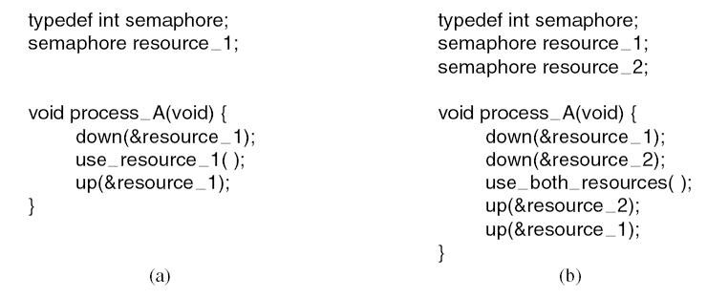
Resource Acquisition (1)
Figure 6-1. Using a semaphore to protect resources.
(a) One resource. (b) Two resources.
Tanenbaum, Modern Operating Systems 3 e, (c) 2008 Prentice-Hall, Inc. All rights reserved. 0-13-6006639

Slide 4
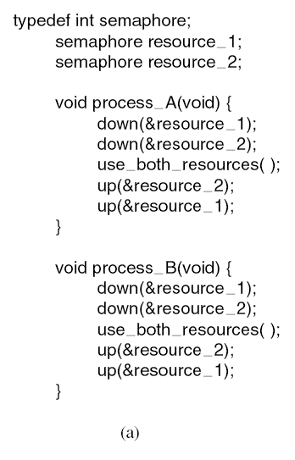
Resource Acquisition (2)
Figure 6-2. (a) Deadlock-free code.
Tanenbaum, Modern Operating Systems 3 e, (c) 2008 Prentice-Hall, Inc. All rights reserved. 0-13-6006639

Slide 5
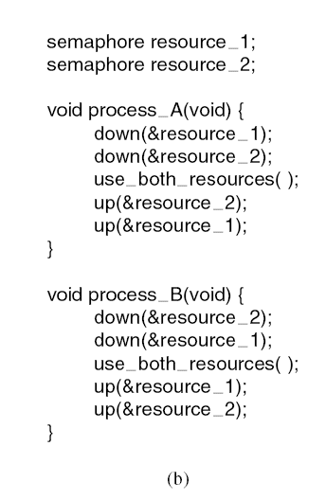
Resource Acquisition (3)
Figure 6-2. (b) Code with a potential deadlock.
Tanenbaum, Modern Operating Systems 3 e, (c) 2008 Prentice-Hall, Inc. All rights reserved. 0-13-6006639

Slide 6
Introduction To Deadlocks
Deadlock can be defined formally as follows:
A set of processes is deadlocked if each process in the set is waiting for an event that only another process in the set can cause.
Tanenbaum, Modern Operating Systems 3 e, (c) 2008 Prentice-Hall, Inc. All rights reserved. 0-13-6006639

Slide 7
Conditions for Resource Deadlocks
Mutual exclusion condition
Hold and wait condition.
No preemption condition.
Circular wait condition.
Tanenbaum, Modern Operating Systems 3 e, (c) 2008 Prentice-Hall, Inc. All rights reserved. 0-13-6006639

Slide 8
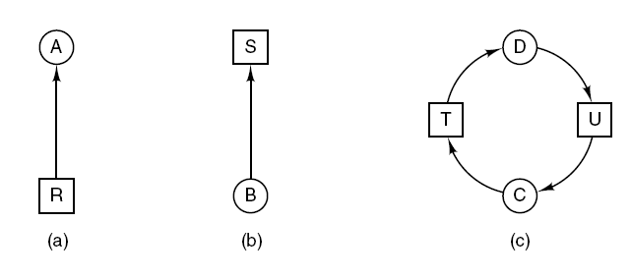
Deadlock Modeling (1)
Figure 6-3. Resource allocation graphs. (a) Holding a resource. (b) Requesting a resource. (c) Deadlock.
Tanenbaum, Modern Operating Systems 3 e, (c) 2008 Prentice-Hall, Inc. All rights reserved. 0-13-6006639

Slide 9
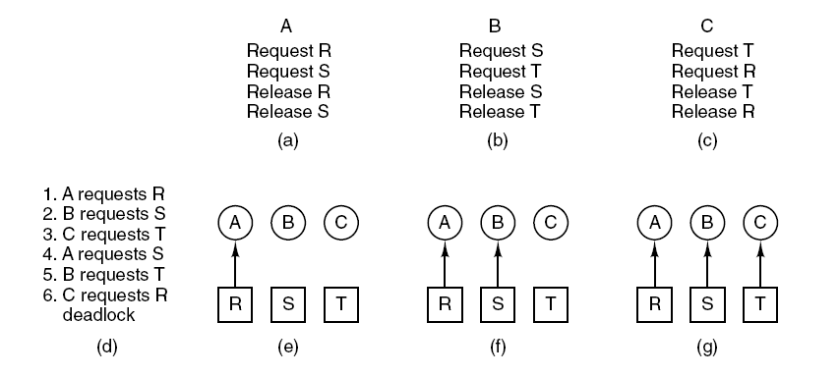
Deadlock Modeling (2)
Figure 6-4. An example of how deadlock occurs
and how it can be avoided.
Tanenbaum, Modern Operating Systems 3 e, (c) 2008 Prentice-Hall, Inc. All rights reserved. 0-13-6006639

Slide 10
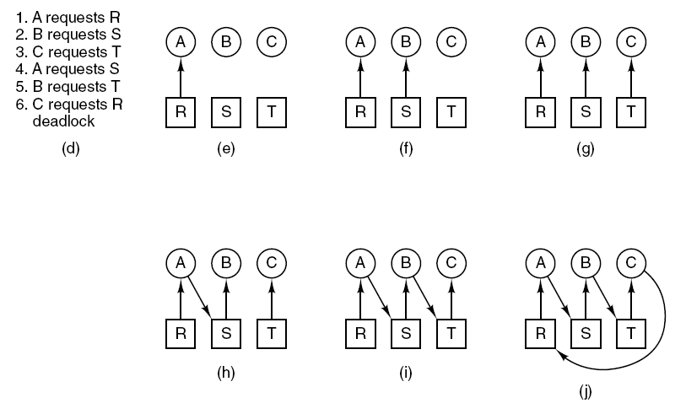
Deadlock Modeling (3)
Figure 6-4. An example of how deadlock occurs
and how it can be avoided.
Tanenbaum, Modern Operating Systems 3 e, (c) 2008 Prentice-Hall, Inc. All rights reserved. 0-13-6006639

Slide 11
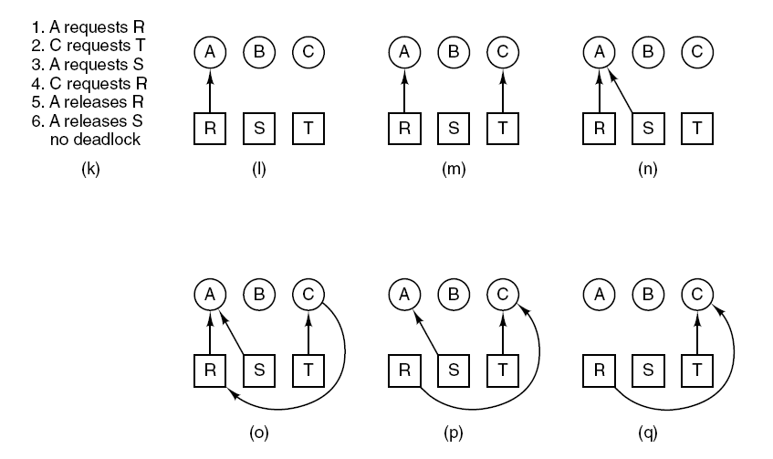
Deadlock Modeling (4)
Figure 6-4. An example of how deadlock occurs
and how it can be avoided.
Tanenbaum, Modern Operating Systems 3 e, (c) 2008 Prentice-Hall, Inc. All rights reserved. 0-13-6006639

Slide 12
Deadlock Modeling (5)
Strategies for dealing with deadlocks:
Just ignore the problem.
Detection and recovery. Let deadlocks occur, detect them, take action.
Dynamic avoidance by careful resource allocation.
Prevention, by structurally negating one of the four required conditions.
Tanenbaum, Modern Operating Systems 3 e, (c) 2008 Prentice-Hall, Inc. All rights reserved. 0-13-6006639

Slide 13
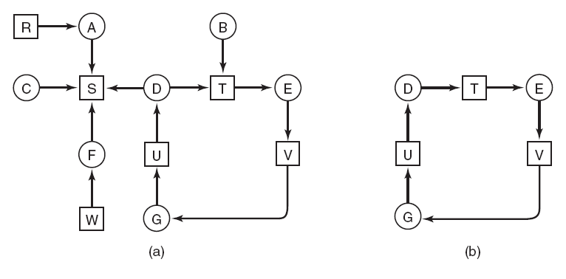
Deadlock Detection with
One Resource of Each Type (1)
Figure 6-5. (a) A resource graph. (b) A cycle extracted from (a).
Tanenbaum, Modern Operating Systems 3 e, (c) 2008 Prentice-Hall, Inc. All rights reserved. 0-13-6006639

Slide 14
Deadlock Detection with
One Resource of Each Type (2)
Algorithm for detecting deadlock:
For each node, N in the graph, perform the following five steps with N as the starting node.
Initialize L to the empty list, designate all arcs as unmarked.
Add current node to end of L, check to see if node now appears in L two times. If it does, graph contains a cycle (listed in L), algorithm terminates.
…
Tanenbaum, Modern Operating Systems 3 e, (c) 2008 Prentice-Hall, Inc. All rights reserved. 0-13-6006639

Slide 15
Deadlock Detection with
One Resource of Each Type (3)
From given node, see if any unmarked outgoing arcs. If so, go to step 5; if not, go to step 6.
Pick an unmarked outgoing arc at random and mark it. Then follow it to the new current node and go to step 3.
If this is initial node, graph does not contain any cycles, algorithm terminates. Otherwise, dead end. Remove it, go back to previous node, make that one current node, go to step 3.
Tanenbaum, Modern Operating Systems 3 e, (c) 2008 Prentice-Hall, Inc. All rights reserved. 0-13-6006639

Slide 16
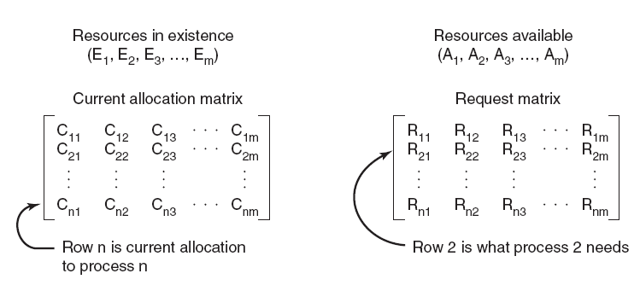
Deadlock Detection with Multiple Resources of Each Type (1)
Figure 6-6. The four data structures needed
by the deadlock detection algorithm.
Tanenbaum, Modern Operating Systems 3 e, (c) 2008 Prentice-Hall, Inc. All rights reserved. 0-13-6006639

Slide 17
Deadlock Detection with Multiple Resources of Each Type (2)
Deadlock detection algorithm:
Look for an unmarked process, P_{i} , for which the i-th row of R is less than or equal to A.
If such a process is found, add the i-th row of C to A, mark the process, and go back to step 1.
If no such process exists, the algorithm terminates.
Tanenbaum, Modern Operating Systems 3 e, (c) 2008 Prentice-Hall, Inc. All rights reserved. 0-13-6006639

Slide 18
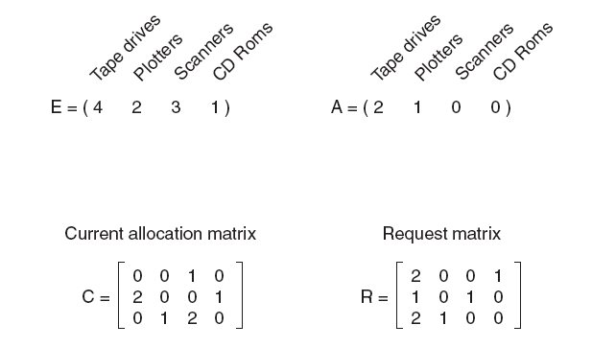
Deadlock Detection with Multiple Resources of Each Type (3)
Figure 6-7. An example for the deadlock detection algorithm.
Tanenbaum, Modern Operating Systems 3 e, (c) 2008 Prentice-Hall, Inc. All rights reserved. 0-13-6006639

Slide 19
Recovery from Deadlock
Recovery through preemption
Recovery through rollback
Recovery through killing processes
Tanenbaum, Modern Operating Systems 3 e, (c) 2008 Prentice-Hall, Inc. All rights reserved. 0-13-6006639

Slide 20
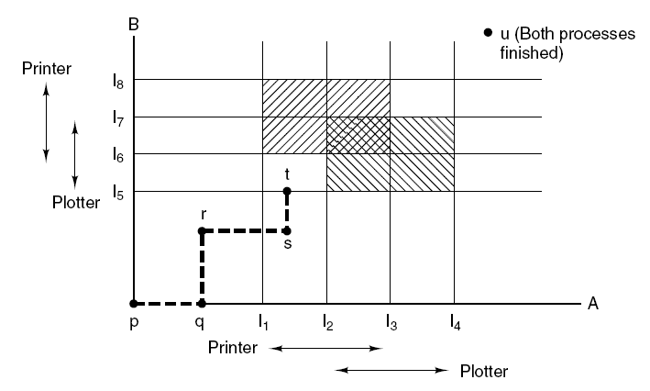
Deadlock Avoidance
Figure 6-8. Two process resource trajectories.
Tanenbaum, Modern Operating Systems 3 e, (c) 2008 Prentice-Hall, Inc. All rights reserved. 0-13-6006639

Slide 21
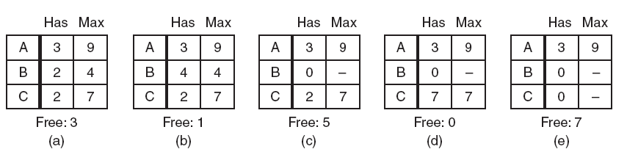
Safe and Unsafe States (1)
Figure 6-9. Demonstration that the state in (a) is safe.
Tanenbaum, Modern Operating Systems 3 e, (c) 2008 Prentice-Hall, Inc. All rights reserved. 0-13-6006639

Slide 22
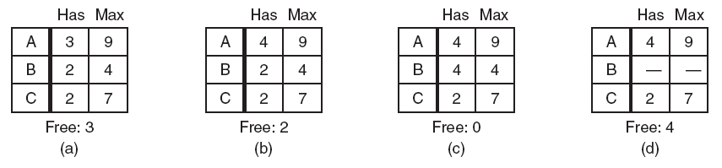
Safe and Unsafe States (2)
Figure 6-10. Demonstration that the state in (b) is not safe.
Tanenbaum, Modern Operating Systems 3 e, (c) 2008 Prentice-Hall, Inc. All rights reserved. 0-13-6006639

Slide 23
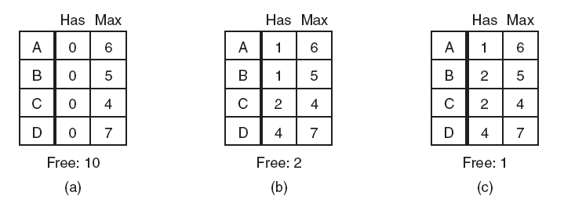
The Banker’s Algorithm for a Single Resource
Figure 6-11. Three resource allocation states:
(a) Safe. (b) Safe. (c) Unsafe.
Tanenbaum, Modern Operating Systems 3 e, (c) 2008 Prentice-Hall, Inc. All rights reserved. 0-13-6006639

Slide 24
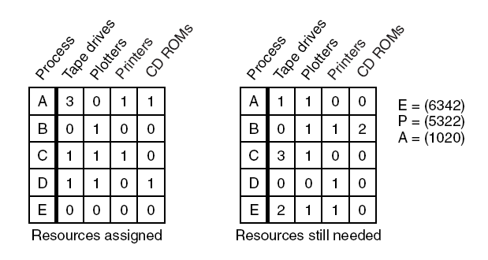
The Banker’s Algorithm for Multiple Resources (1)
Figure 6-12. The banker’s algorithm with multiple resources.
Tanenbaum, Modern Operating Systems 3 e, (c) 2008 Prentice-Hall, Inc. All rights reserved. 0-13-6006639

Slide 25
The Banker’s Algorithm for Multiple Resources (2)
Algorithm for checking to see if a state is safe:
Look for row, R, whose unmet resource needs all
≤ A. If no such row exists, system will eventually deadlock since no process can run to completion
Assume process of row chosen requests all resources it needs and finishes. Mark process as terminated, add all its resources to the A vector.
Repeat steps 1 and 2 until either all processes marked terminated (initial state was safe) or no process left whose resource needs can be met (there is a deadlock).
Tanenbaum, Modern Operating Systems 3 e, (c) 2008 Prentice-Hall, Inc. All rights reserved. 0-13-6006639

Slide 26
Deadlock Prevention
Attacking the mutual exclusion condition
Attacking the hold and wait condition
Attacking the no preemption condition
Attacking the circular wait condition
Tanenbaum, Modern Operating Systems 3 e, (c) 2008 Prentice-Hall, Inc. All rights reserved. 0-13-6006639

Slide 27
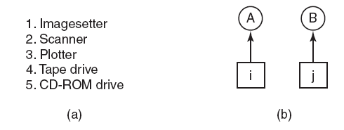
Attacking the
Circular Wait Condition
Figure 6-13. (a) Numerically ordered resources.
(b) A resource graph.
Tanenbaum, Modern Operating Systems 3 e, (c) 2008 Prentice-Hall, Inc. All rights reserved. 0-13-6006639

Slide 28
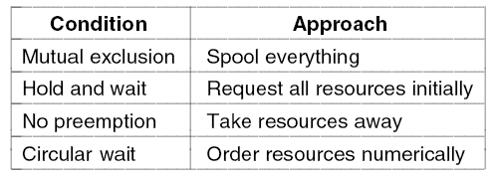
Approaches to Deadlock Prevention
Figure 6-14. Summary of approaches to deadlock prevention.
Tanenbaum, Modern Operating Systems 3 e, (c) 2008 Prentice-Hall, Inc. All rights reserved. 0-13-6006639

Slide 29
Other Issues
Two-phase locking
Communication deadlocks
Livelock
Starvation
Tanenbaum, Modern Operating Systems 3 e, (c) 2008 Prentice-Hall, Inc. All rights reserved. 0-13-6006639

Slide 30
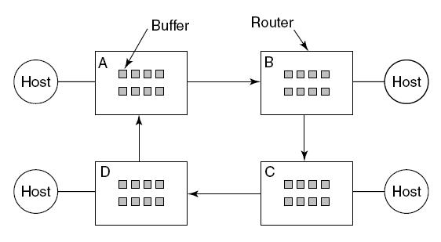
Communication Deadlocks
Figure 6-15. A resource deadlock in a network.
Tanenbaum, Modern Operating Systems 3 e, (c) 2008 Prentice-Hall, Inc. All rights reserved. 0-13-6006639

Slide 31
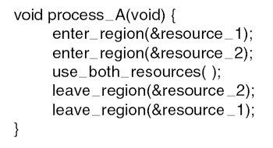
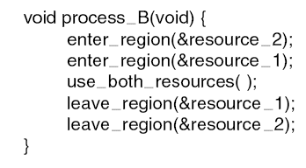
Livelock
Figure 6-16. Busy waiting that can lead to livelock.
Tanenbaum, Modern Operating Systems 3 e, (c) 2008 Prentice-Hall, Inc. All rights reserved. 0-13-6006639

